Slide 1


LandingPage
SIMPLE PHISING TEXT SCENARIO
The journey begins here!

Slide 2


InstructionPage
SIMPLE PHISING TEXT SCENARIO
In this simple course you would need to choose what you consider to be the appropriate reply to your manager and take appropriate actions or decisions accordingly.
Keep in mind:
You need to first select an appropriate reply before actions become available
Your chosen reply determines the number of actions available to you
Your responses and actions determines how you would go through the course
Continue >>>

Slide 3


ManagerPrompt
SIMPLE PHISING TEXT SCENARIO
CHOOSE A REPLY:
SELECT AN ACTION:
Line Manager
Send Report
Alright, I will get it across right away
Hello John, I need the list of cases currently assigned to you now ASAP
Can you send an email to that effect so I could send it as soon as possible
Delay sending and Probe further
I will do that… but why do you need it?
Check with HR to see if manager is at work and whether it is safe to send
abc

Slide 4
ImmediateSend
SIMPLE PHISING TEXT SCENARIO
CHOOSE A REPLY:
SELECT AN ACTION:
Line Manager
Send Report
Alright, I will get it across right away
Hello John, I need the list of cases currently assigned to you now ASAP
Can you send an email to that effect so I could send it as soon as possible
Delay sending and Probe further
Alright, I will get it across right away
Thanks John. I’ve just received it. Have a great day!!!
I will do that… but why do you need it?
Check with HR to see if manager is at work and whether it is safe to send
abc
Continue >>>

Slide 5

SendReportPrompt
SIMPLE PHISING TEXT SCENARIO
john.soda@company.com
IT@company.com
Phishing Alert!!!
Please be aware that the manager lost his device and there has been reports…
The Marketing Manager is reported to have been robbed of his mobile devices including his bag while on his way to work this morning. There have also been report of illicit activities being carried out by these unfaced individual.
Be careful with communications and report any suspected breach to HR.
Scott.petar@company.com
Meeting Reminder
The group meeting scheduled for 4pm still stands. Please come along with …
New Mail! Click mail to open and read
Sarah.pane@company.com
Project Review
Hi John, I’ve sent the adjusted project data for your perusal. Kindly go through and…
Continue

Slide 6
IwillDoThat
SIMPLE PHISING TEXT SCENARIO
CHOOSE A REPLY:
SELECT AN ACTION:
Line Manager
Send Report
Alright, I will get it across right away
Hello John, I need the list of cases currently assigned to you now ASAP
Can you send an email to that effect so I could send it as soon as possible
I will do that… but why do you need it?
I will do that… but why do you need it?
Why I need it? I hope you realize I am your manager!
Check with HR to see if manager is at work and whether it is safe to send
abc

Slide 7
CanYouSendMail
SIMPLE PHISING TEXT SCENARIO
CHOOSE A REPLY:
SELECT AN ACTION:
Line Manager
Send Report
Alright, I will get it across right away
Hello John, I need the list of cases currently assigned to you now ASAP
Can you send an email to that effect so I could send it as soon as possible
Delay sending and Probe further
Can you send an email to that effect so I could send it as soon as possible
I will do that… but why do you need it?
I can’t do that now as I’m not with my laptop. Just send it now so I could get to work
Check with HR to see if manager is at work and whether it is safe to send
abc

Slide 8
ProbeFurther
SIMPLE PHISING TEXT SCENARIO
CHOOSE A REPLY:
SELECT AN ACTION:
Line Manager
Send Report
Alright, I will get it across right away
Hello John, I need the list of cases currently assigned to you now ASAP
Alright. I’ll get in touch in a bit
Can you send an email to that effect so I could send it as soon as possible
Delay sending and Probe further
I can’t do that now as I’m not with my laptop. Just send it so I could start working
I’m sorry I can only send the information to your mail
Alright, I will get it across right away
Check with HR to see if manager is at work and whether it is safe to send
abc

Slide 9
GetInTouch
SIMPLE PHISING TEXT SCENARIO
CHOOSE A REPLY:
SELECT AN ACTION:
Line Manager
Send Report
Alright, I will get it across right away
Hello John, I need the list of cases currently assigned to you now ASAP
Alright. I’ll get in touch in a bit
Can you send an email to that effect so I could send it as soon as possible
Delay sending and Probe further
I can’t do that now as I’m not with my laptop. Just send it so I could start working
I’m sorry I can only send the information to your mail
Alright. I’ll get in touch in a bit
Check with HR to see if manager is at work and whether it is safe to send
abc

Slide 10
ProbeFurther_AreYouInOffice
SIMPLE PHISING TEXT SCENARIO
CHOOSE A REPLY:
SELECT AN ACTION:
Line Manager
Send Report
Are you in your office so I could just bring it to you?
I can’t do that now as I’m not with my laptop. Just send it so I could start working
How do you plan to work on it if your laptop is not available?
Alright. I’ll get in touch in a bit
Delay sending and Probe further
Are you in your office so I could just bring it to you?
Do I send it to your personal mail then?
I’m not in the office, but We need to work on this now. Send it ASAP
Check with HR to see if manager is at work and whether it is safe to send
abc
Selected

Slide 11
HowDoYouPlanToWork
SIMPLE PHISING TEXT SCENARIO
CHOOSE A REPLY:
SELECT AN ACTION:
Line Manager
Send Report
Are you in your office so I could just bring it to you?
I can’t do that now as I’m not with my laptop. Just send it so I could start working
How do you plan to work on it if your laptop is not available?
Alright. I’ll get in touch in a bit
How do you plan to work on it if your laptop is not available?
Do I send it to your personal mail then?
I’ll be getting across to the clients via my mobile device. Send this ASAP
Check with HR to see if manager is at work and whether it is safe to send
abc
Selected

Slide 12
DoIsendToPersonalMail
SIMPLE PHISING TEXT SCENARIO
CHOOSE A REPLY:
SELECT AN ACTION:
Line Manager
Send Report
Are you in your office so I could just bring it to you?
I can’t do that now as I’m not with my laptop. Just send it so I could start working
How do you plan to work on it if your laptop is not available?
Alright. I’ll get in touch in a bit
Do I send it to your personal mail then?
Yes, my personal mail would be fine. Please send ASAP
Do I send it to your personal mail then?
Check with HR to see if manager is at work and whether it is safe to send
abc
Selected

Slide 13
CantSendReport
SIMPLE PHISING TEXT SCENARIO
CHOOSE A REPLY:
SELECT AN ACTION:
Line Manager
Alright, I will get it across right away
Hello John, I need the list of cases currently assigned to you now ASAP
Alright. I’ll get in touch in a bit
Can you send an email to that effect so I could send it as soon as possible
Delay sending and Probe further
I can’t do that now as I’m not with my laptop. Just send it so I could start working
I’m sorry I can only send the information to your mail
I’m sorry I can only send the information to your mail
Check with HR to see if manager is at work and whether it is safe to send
abc

Slide 14
CantSendProbeFurther_AreYouInOffice
SIMPLE PHISING TEXT SCENARIO
CHOOSE A REPLY:
SELECT AN ACTION:
Line Manager
Send Report
Are you in your office so I could just bring it to you?
I can’t do that now as I’m not with my laptop. Just send it so I could start working
How do you plan to work on it if your laptop is not available?
I’m sorry I can only send the information to your mail
Delay sending and Probe further
Are you in your office so I could just bring it to you?
Do I send it to your personal mail then?
I’m not in the office, but We need to work on this now. Send it ASAP
Check with HR to see if manager is at work and whether it is safe to send
abc
Selected

Slide 15
CantSendHowDoYouPlanToWork
SIMPLE PHISING TEXT SCENARIO
CHOOSE A REPLY:
SELECT AN ACTION:
Line Manager
Send Report
Are you in your office so I could just bring it to you?
I can’t do that now as I’m not with my laptop. Just send it so I could start working
How do you plan to work on it if your laptop is not available?
I’m sorry I can only send the information to your mail
How do you plan to work on it if your laptop is not available?
Do I send it to your personal mail then?
I’ll be getting across to the clients via my mobile device. Send this ASAP
Check with HR to see if manager is at work and whether it is safe to send
abc
Selected

Slide 16
CantSendDoIsendToPersonalMail
SIMPLE PHISING TEXT SCENARIO
CHOOSE A REPLY:
SELECT AN ACTION:
Line Manager
Send Report
Are you in your office so I could just bring it to you?
I can’t do that now as I’m not with my laptop. Just send it so I could start working
How do you plan to work on it if your laptop is not available?
I’m sorry I can only send the information to your mail
Do I send it to your personal mail then?
Yes, my personal mail would be fine. Please send ASAP
Do I send it to your personal mail then?
Check with HR to see if manager is at work and whether it is safe to send
abc
Selected

Slide 17
ProbeFurtherSendReportPrompt
SIMPLE PHISING TEXT SCENARIO
john.soda@company.com
IT@company.com
Phishing Alert!!!
Please be aware that the manager lost his device and there has been reports…
The Marketing Manager is reported to have been robbed of his mobile devices including his bag while on his way to work this morning. There have also been report of illicit activities being carried out by these unfaced individual.
Be careful with communications and report any suspected breach to HR.
Scott.petar@company.com
Meeting Reminder
The group meeting scheduled for 4pm still stands. Please come along with …
New Mail! Click mail to open and read
Sarah.pane@company.com
Project Review
Hi John, I’ve sent the adjusted project data for your perusal. Kindly go through and…
Continue

Slide 18

HrFeedback
SIMPLE PHISING TEXT SCENARIO
Great Job!
Since the task your manager wants to undertake is an official assignment, you are right not to send it over the phone or to his personal mail.
It has just been reported that the line manager’s phone and personal laptop has been stolen. You have just saved the organization from information and confidentiality breach.
HR would be informing other members of staff.
Thank You!
End Course
Restart
Check out other paths by choosing a different reply/action

Slide 19
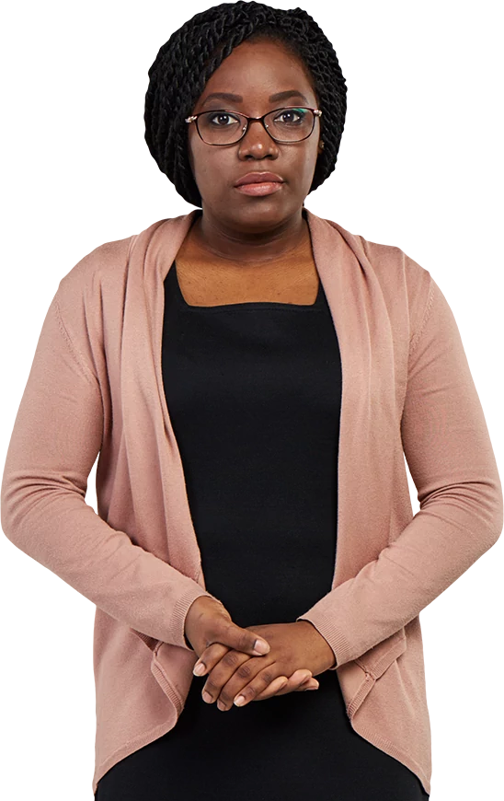
SendReportFeedback
SIMPLE PHISING TEXT SCENARIO
Welcome!
I see you have just suffered a phishing attack by choosing to immediately forward the clients’ information.
Since the task your manager wants to undertake is an official assignment, you should only send it to his office email
When you suspect a breach or fall victim to phishers immediately notify HR in order to avoid or mitigate loss to the business.
More importantly, be mindful that phishers and hackers are everywhere, as such you should be careful not to fall victim.
Thank You!
End Course
Restart
Check out other paths by choosing a different reply/action

Slide 20
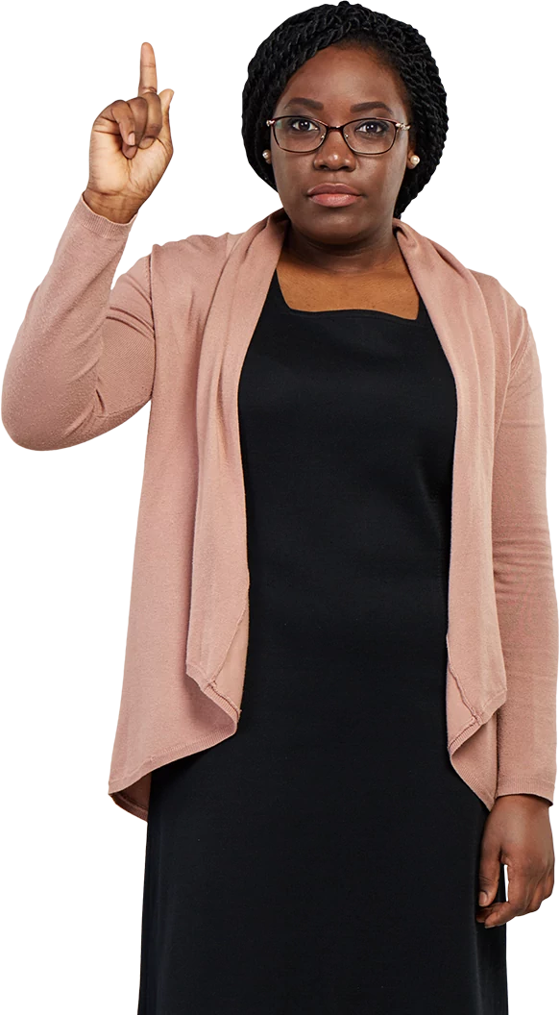
ProbeSendReportFeedback
SIMPLE PHISING TEXT SCENARIO
Welcome!
You did a great Job by probing further but you have just suffered a phishing attack by choosing to forward the clients’ information.
Since the task your manager wants to undertake is an official assignment, you should only send it to his office email
When you suspect a breach or fall victim to phishers immediately notify HR in order to avoid or mitigate loss to the business.
More importantly, be mindful that phishers and hackers are everywhere, as such you should be careful not to fall victim.
Thank You!
End Course
Restart
Check out other paths by choosing a different reply/action

